Slide 2
DXN MASK PACK
SOFT TENCEL MASK SHEET is extracted from eucalyptus tree and it is soft, breathable, lightweight and comfortable. The mask sheet comes in smooth and silky soft surface that drapes beautifully to flatter every part of your face.

Slide 4
THE MAIN INGREDIENTS
AMETHYST POWDER
SPIRULINA EXTRACT
GANODERMA EXTRACT
MORUS BARK EXTRACT

Slide 5
· Efficacy and Effect
Firmly adheres to the face
Revitalizes the skin
Improves skin tone
Brightening effect
Protects your skin
Restores natural glow
Gives skin moisturizing effect
· NET CONTENT
25 ml
Revitality & Brightening

Slide 7
THE MAIN INGREDIENTS
TEA TREE EXTRACT
PROPOLIS EXTRACT
WITCH HAZEL WATER
GANODERMA EXTRACT

Slide 8
· Efficacy and Effect
Firmly adheres to the face
Provides feeling of skin moisturizing
Instantly soothes the skin
Protects your skin
Improves the appearance of skin
Skin looks rested after application
· NET CONTENT
25 ml
Calming & Tranquilizing

Slide 10
THE MAIN INGREDIENTS
CACAO EXTRACT
COLLAGEN
CENTELLA EXTRACT
GANODERMA EXTRACT

Slide 11
· Efficacy and Effect
Firmly adheres to the face
Vitalizes the skin
Support skin elasticity
Protects your skin
Improves the appearance of skin
Makes skin soft and smooth
· NET CONTENT
25 ml
Elasticity & Vitality

Slide 12
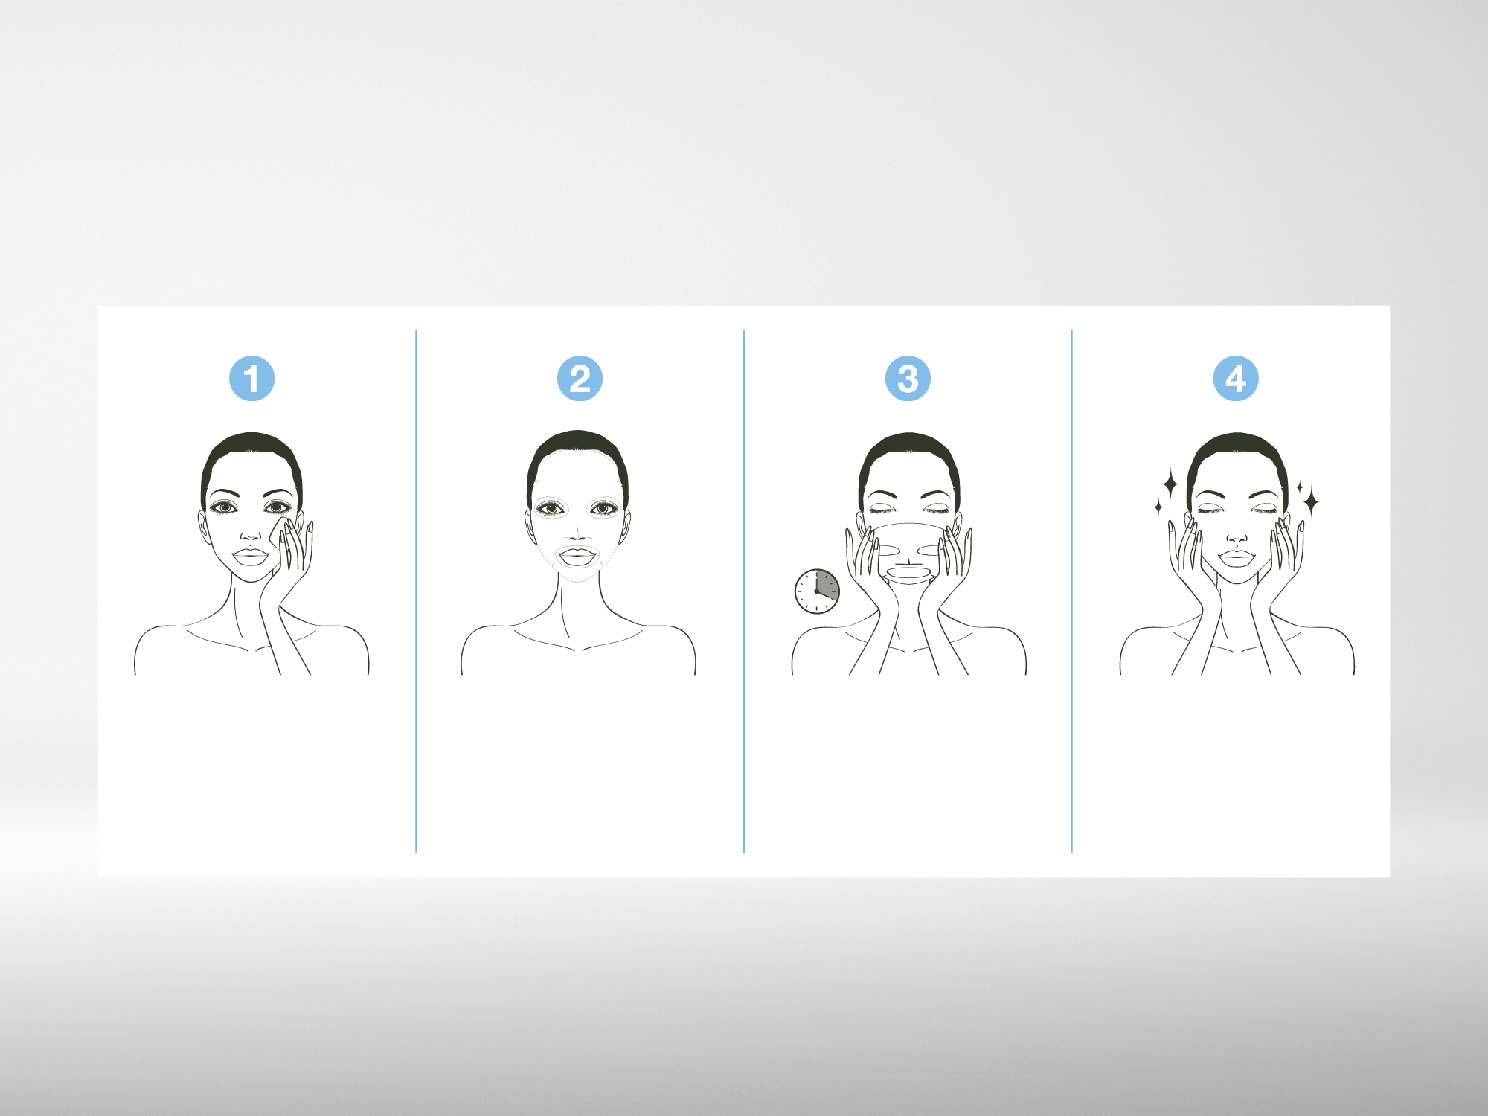
HOW TO USE
Cleanse your face and
apply a toner.
Wear the facial mask
evenly, avoiding the
eyes and mouth.
Leave it on for 15 to 20
minutes and gently
take the mask off.
Tap your face gently until
the essence on your
face is fully absorbed
into the skin.

Slide 13
THANK YOU

